Slide 1
Confest 2020

Slide 2
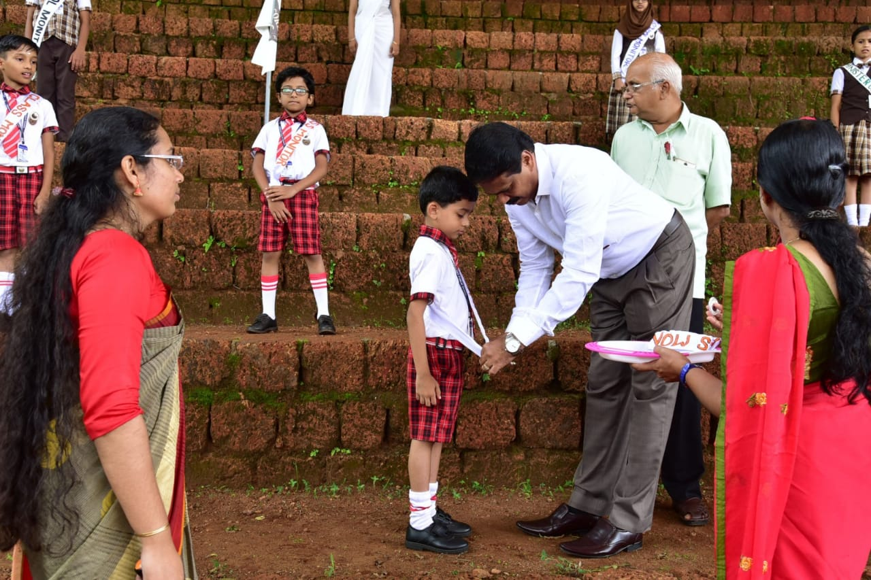
INVESTITURE CEREMONY

Slide 5
INDEPENDENCE DAY

Slide 6
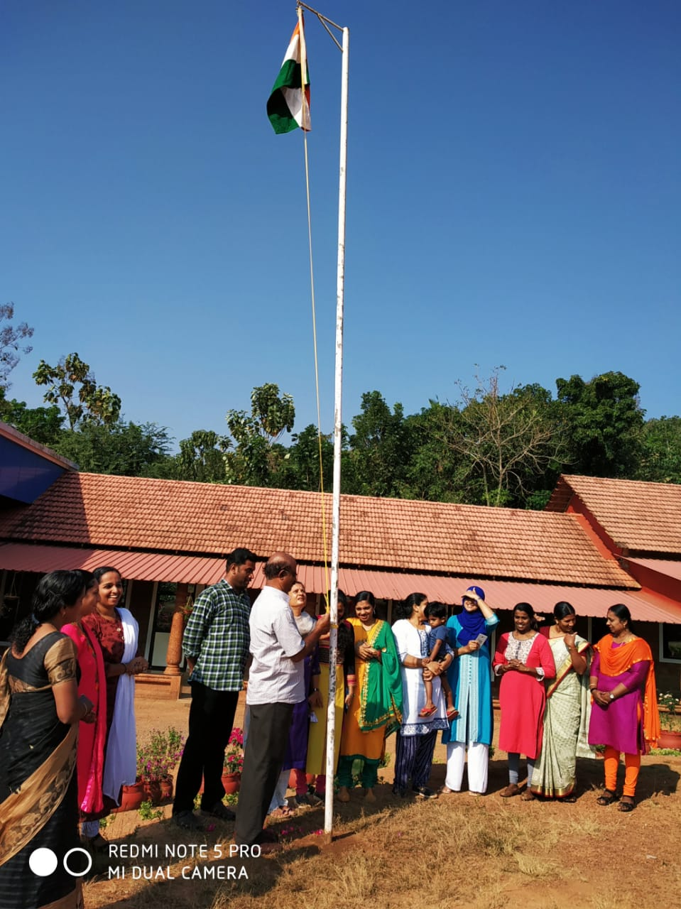

Slide 7
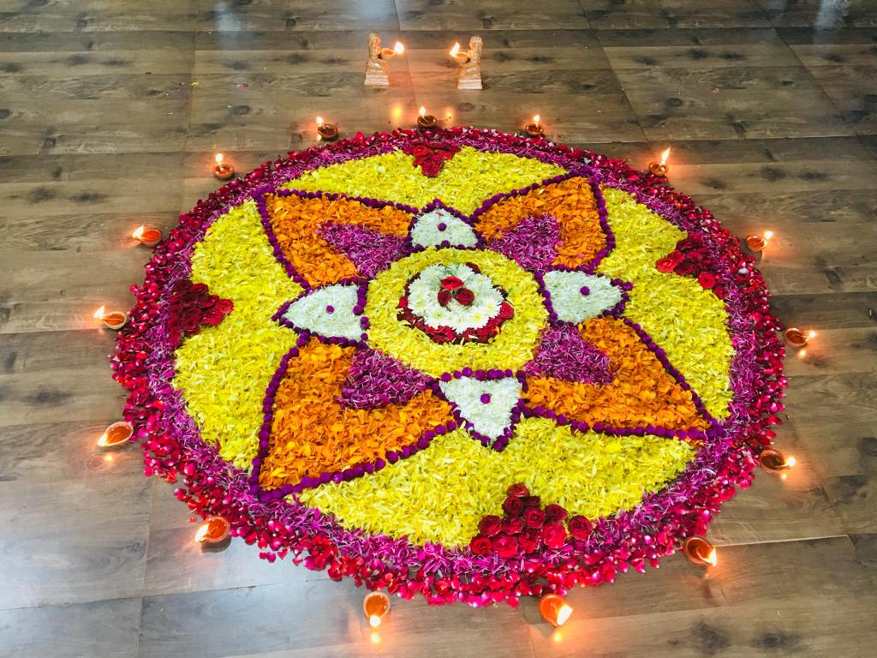
ONAM CELEBRATION

Slide 8
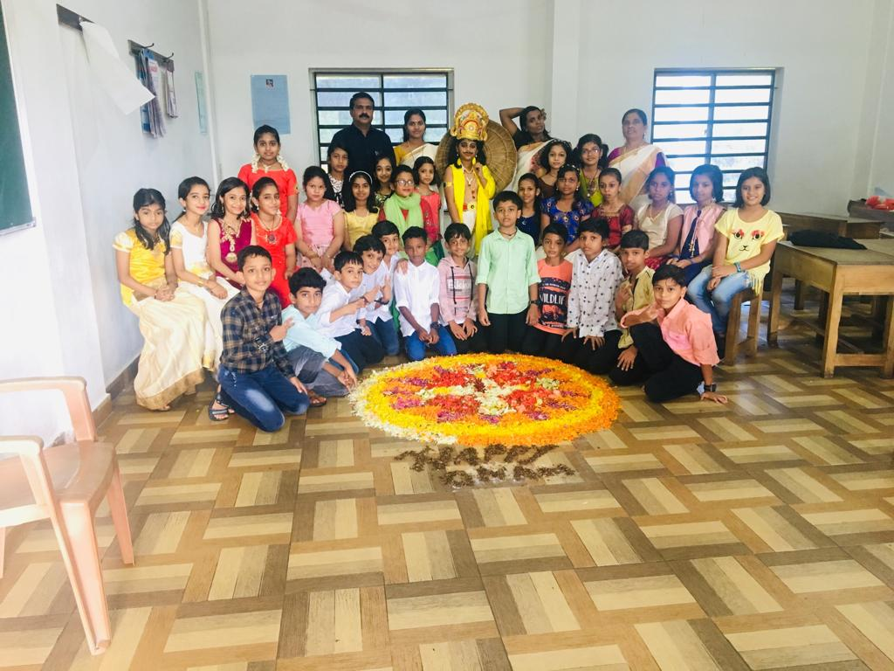

Slide 9
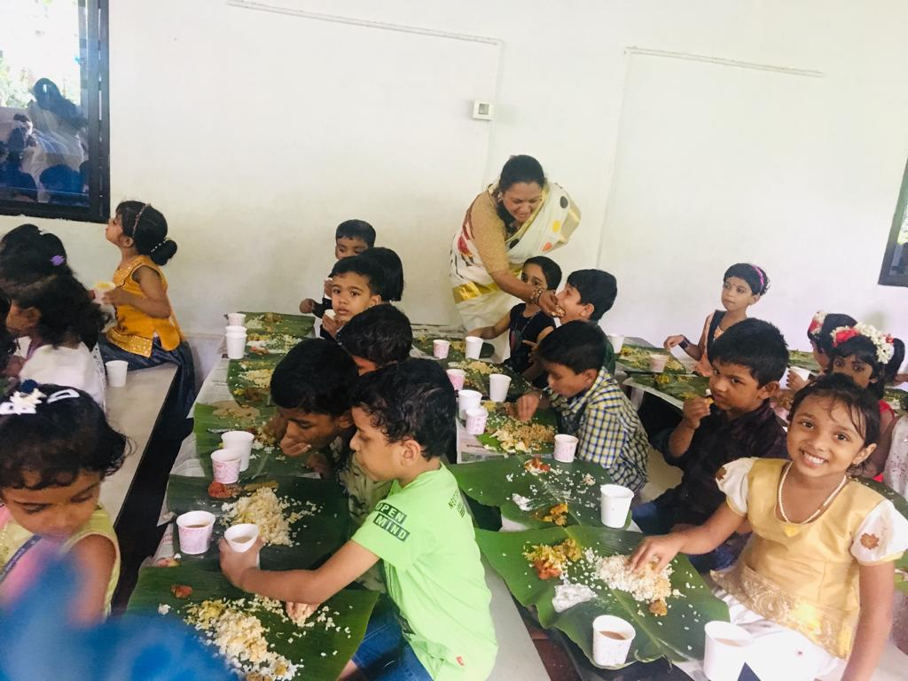
ONAM SADHYA

Slide 10
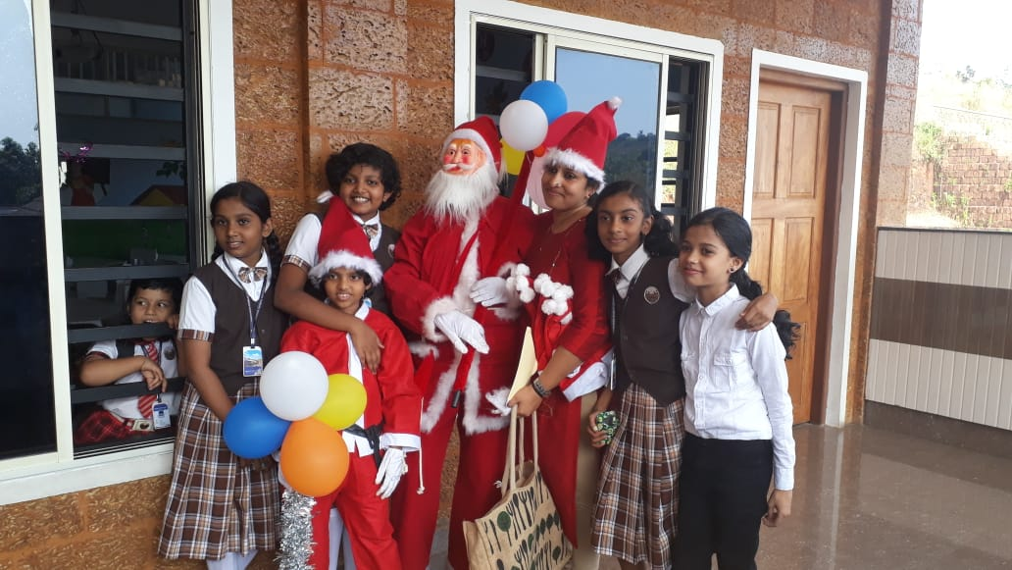
CHRISTHMAS CELEBRATION

Slide 11
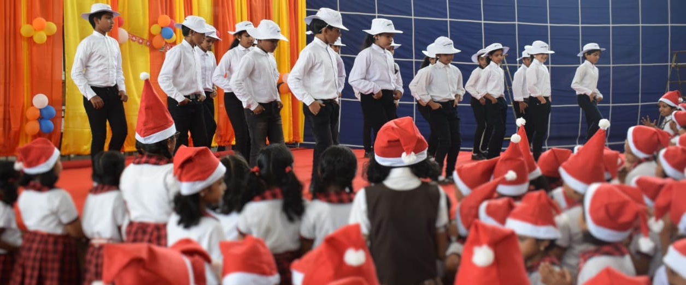

Slide 12
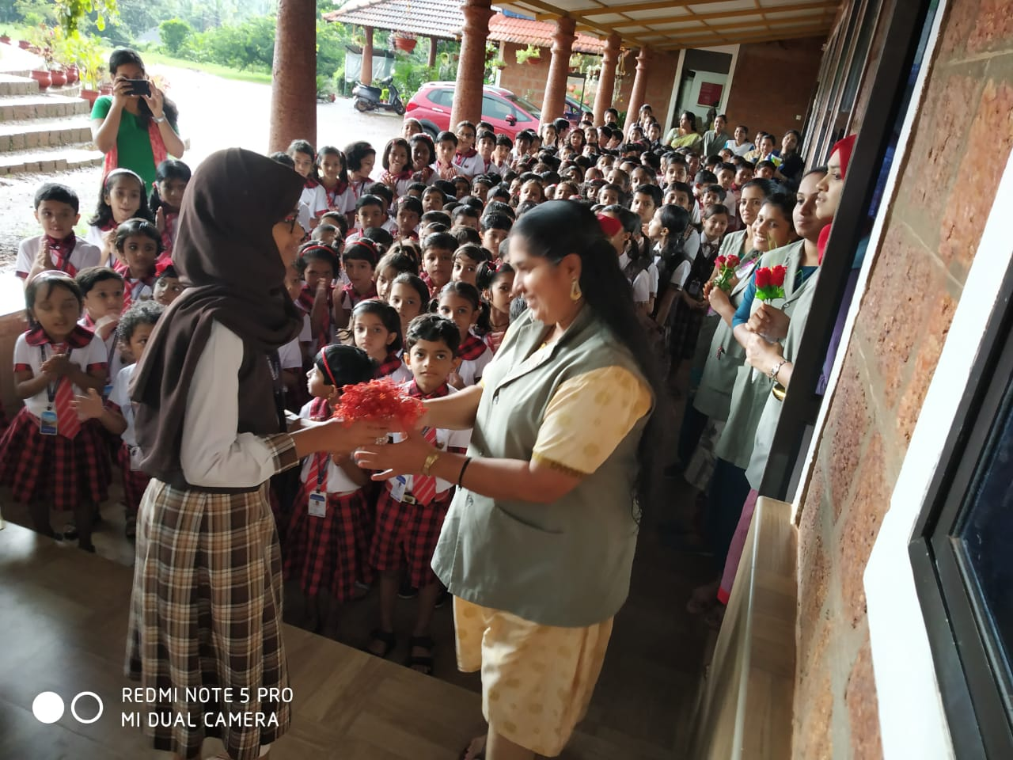
TEACHERS DAY

Slide 13
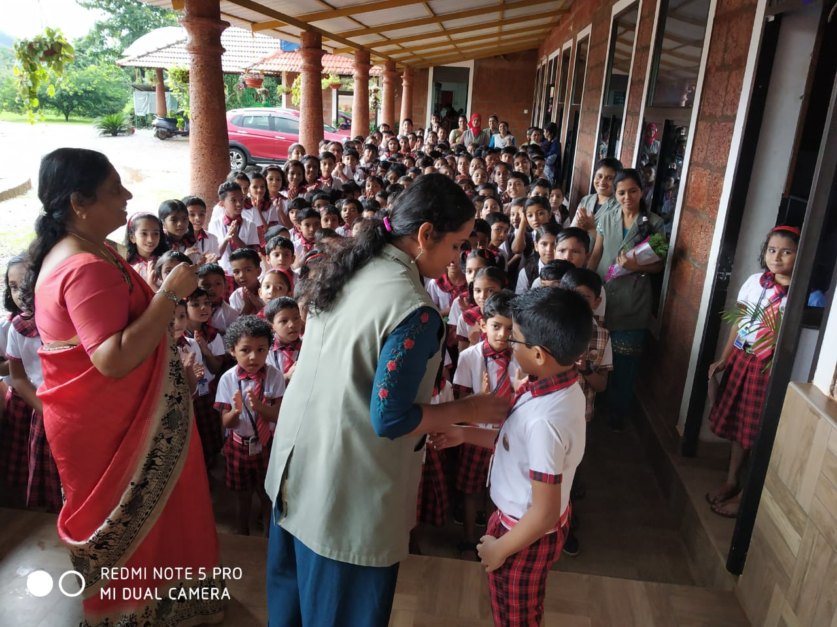

Slide 14
EARTH DAY

Slide 15
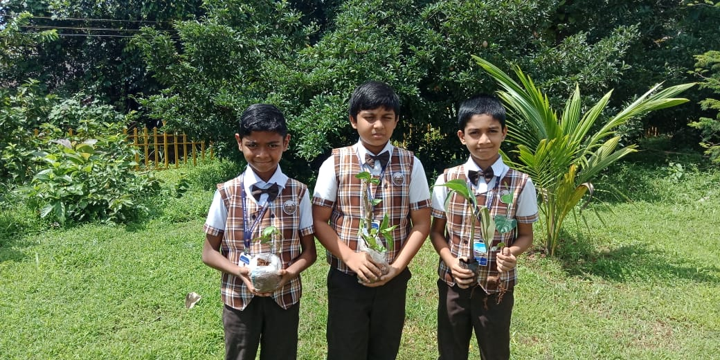

Slide 16
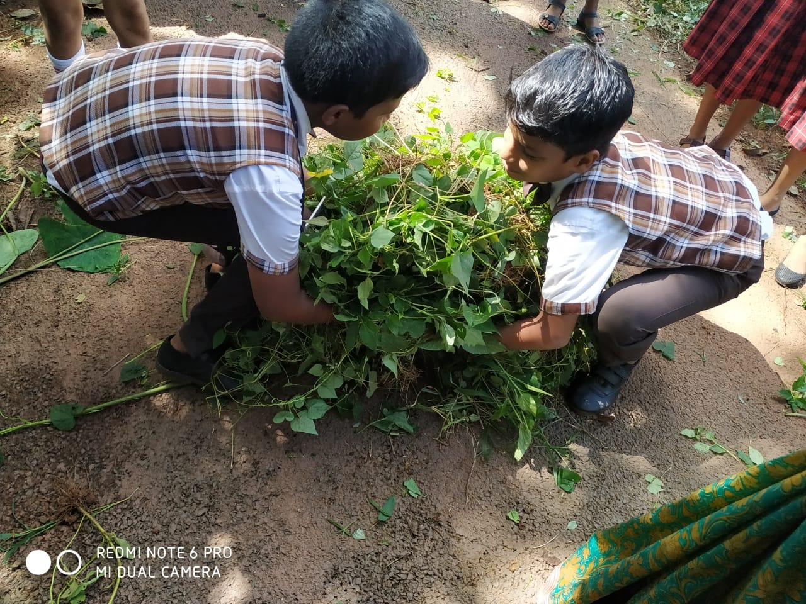
GANDHI JAYANTHI CLEANING

Slide 17
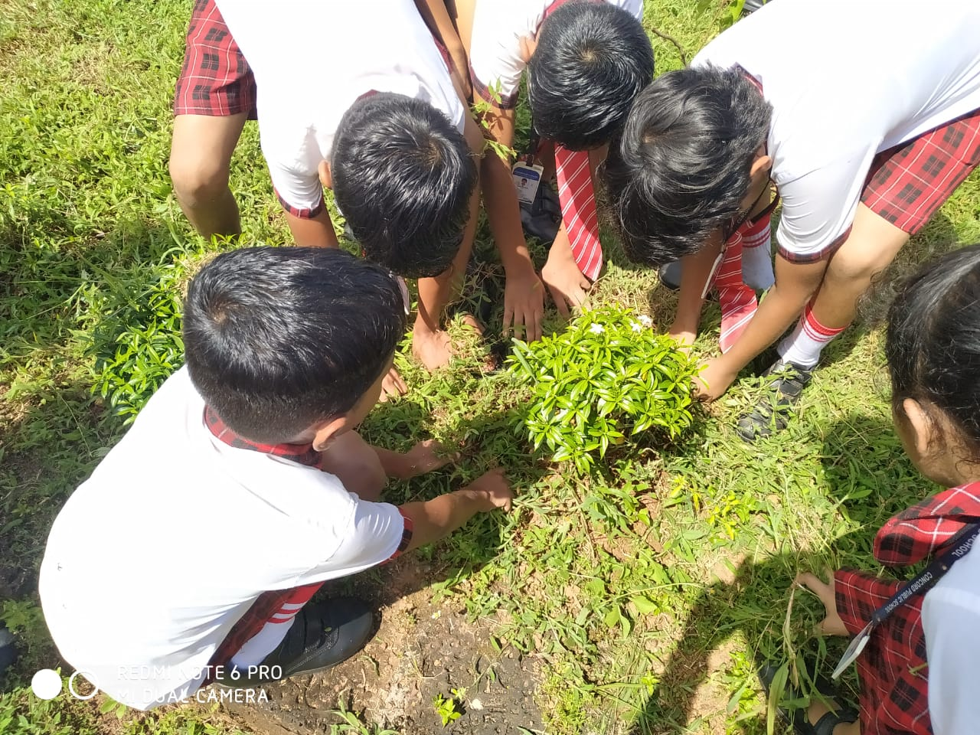

Slide 18
TALENT FEST

Slide 19
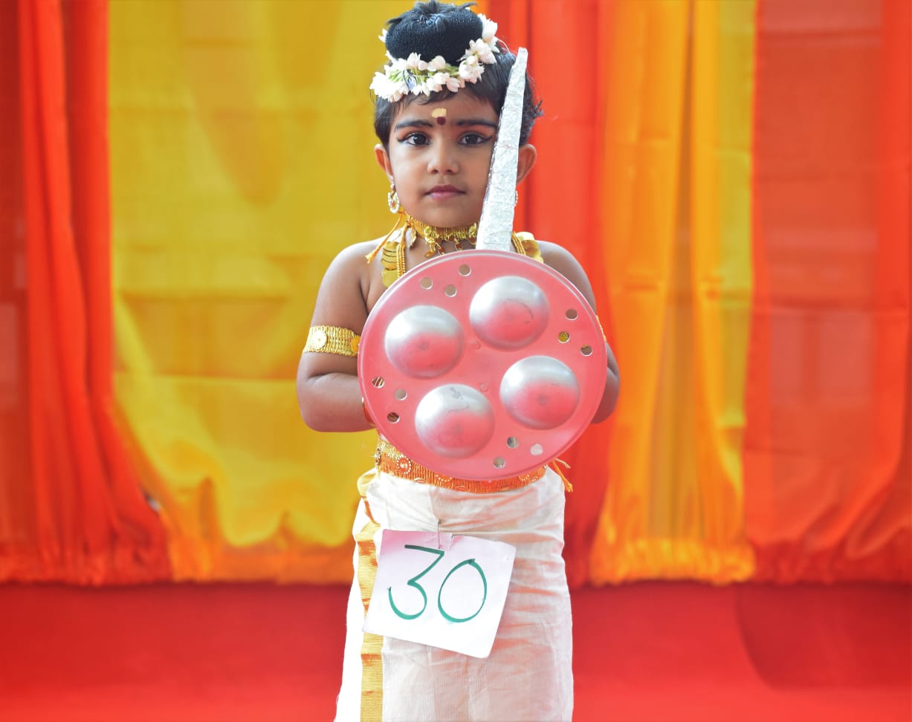

Slide 20
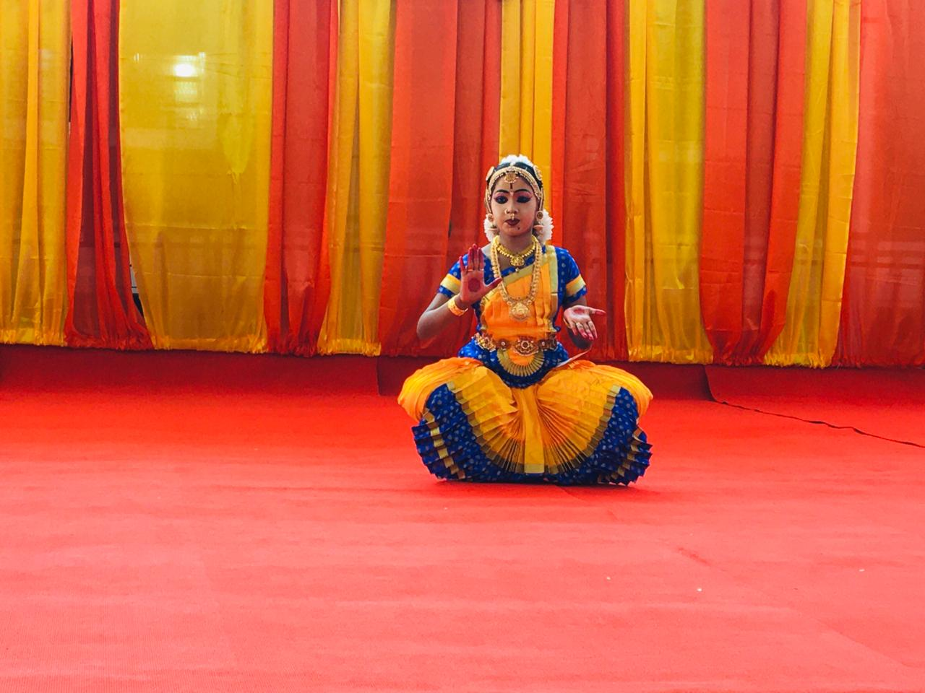

Slide 21
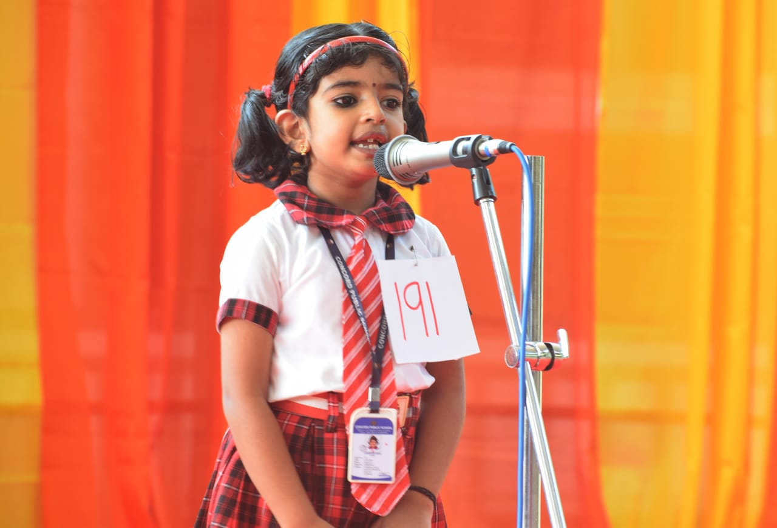

Slide 23
CLASS TOUR

Slide 26
SPORTS DAY

